Slide 1

TELEVISION MARKET ANALYSIS USING WEB SCRAPING
Presented By : Sadhana Bommi Batch No : 546
Branch : Dilsuknagar

Slide 2
About Me :
I have completed my B.Tech in Electrical and Electronics Engineering (EEE) from Annamacharya University.
I chose Data Analytics because I am interested in working with data and understanding what it tells us and I want to improve my analytical and problem-solving skills, so I felt Data Analytics would be a good field for me.
LinkedIn: https://www.linkedin.com/in/bommi-sadhana-541023313/
GitHub: https://github.com/Sadhana3388

Slide 3
Agenda :
✓Business Problem
✓ Project Objectives
✓ Introduction
✓ Tools and Technologies
✓ Data Collection
✓ Dataset Description
✓ Data Cleaning
✓ Data Analysis and Visualization
✓ Testing
✓ Future Scope
✓Conclusion

Slide 4
Business problem :
Television product details such as brands, prices, screen sizes, and discounts are available across multiple listings on the Poorvika website. Manually collecting and comparing this information is time-consuming. Understanding price differences, brand availability, and discount patterns becomes difficult when the information is spread across different product listings.

Slide 5
Objectives:
To collect TV product details from the Poorvika website using web scraping with Selenium.
To clean and organize the collected data for further analysis.
To analyze TV brands, prices, screen sizes, and discount percentages.
To visualize the collected data using charts to identify patterns and trends.
To generate useful insights that help users compare TV products and understand pricing patterns.

Slide 6
Introduction
Television products are available in different brands, price ranges, screen sizes, and discounts on e-commerce platforms.These product details provide useful information for understanding the television market and its pricing trends. This project explores the data from the website using webscraping, it demonstrates how web scraping and data analytics can be combined to transform raw e-commerce data into meaningful information through visualizations and statistical analysis.

Slide 7
Tools & Technologies Used :
Selenium : Automating browser navigation
BeautifulSoup : Extracting data from HTML
Pandas : Data cleaning and analysis
Matplotlib : Creating charts and graphs
Seaborn : Statistical data visualization

Slide 8
Data Collection:
The television product listings were collected from the Poorvika website (https://www.poorvika.com/televisions/s) across multiple pages. The extraction process captured product names, original prices, discounted prices, discount percentages, brands, screen sizes, and product URLs. The collected records were combined into a single dataset for further analysis.

Slide 9
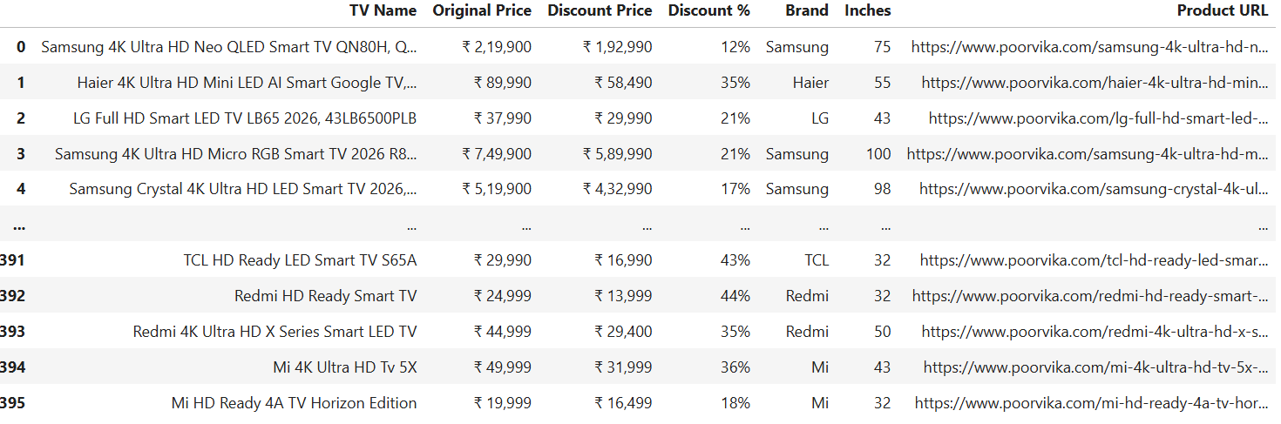
DataFrame Preview

Slide 10
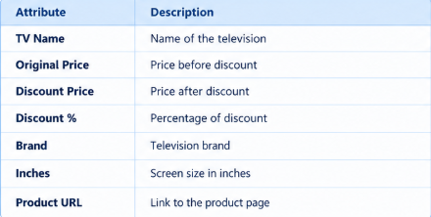
Dataset Description
The dataset contains television product information collected from the Poorvika website. It consists of seven attributes covering product names, original prices, discounted prices, discount percentages, brands, screen sizes, and product URLs. These attributes provide the information needed to compare TV models across different brands and price ranges.

Slide 11
Data Cleaning :
Identified missing values in the dataset and handled them appropriately.
Identified and removed duplicate records.
Removed currency symbols (₹) and commas from price values.
Converted original prices, discounted prices, and discount percentages into numeric format.
Organized the cleaned data into a structured DataFrame for further data analysis and visualization.

Slide 12
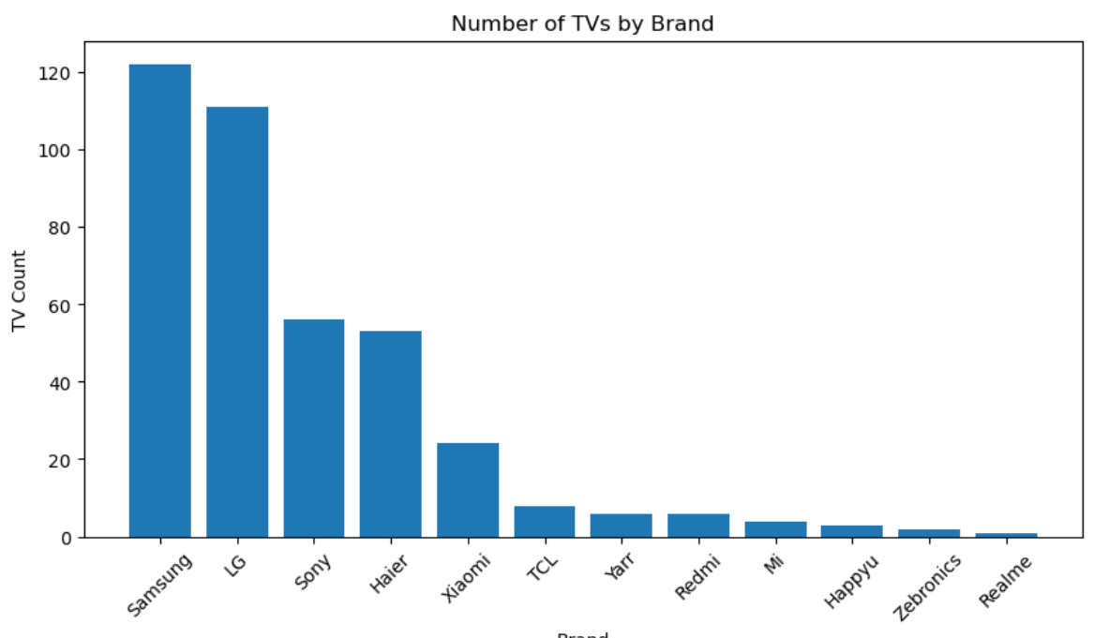
Data Analysis and Visualization :
The collected data was analyzed using statistical methods and visualizations to explore TV pricing, brand distribution, discounts, and screen sizes. Different charts were used to identify patterns and relationships in the dataset.
1. Brand Analysis
This chart shows the number of television models available from different brands.
Insights : The brand with the highest number of models i.e Samsung has the largest product variety in the collected listings.

Slide 13
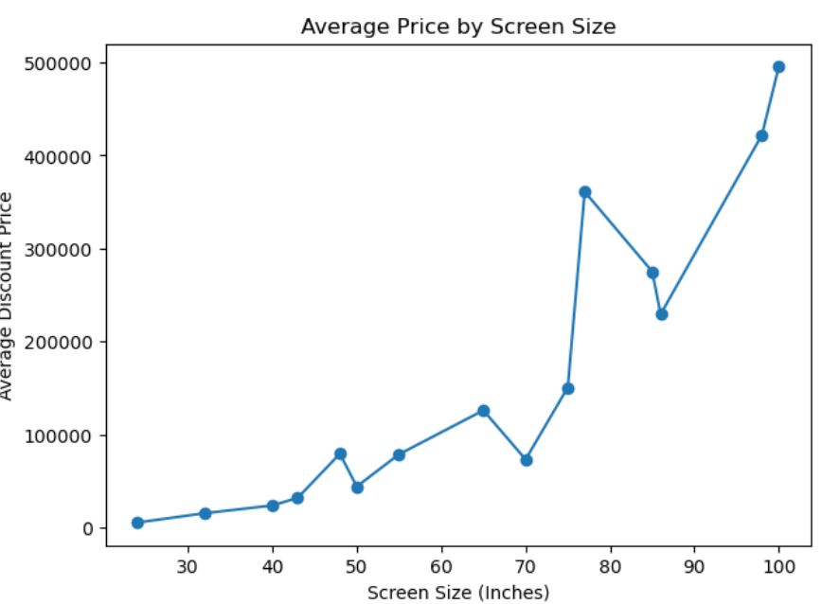
2. Screensize and price
This chart shows the relationship between television screen size and price.
Insight : In general, larger screen sizes tend to have higher average prices, although the price may vary between sizes.

Slide 14
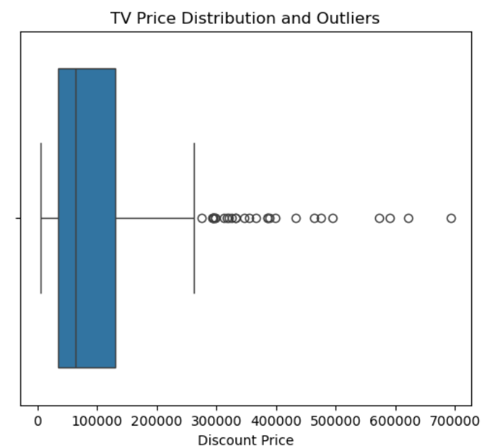
4.Price Outliers
This visualization helps us identify unusually high or low television prices.
Insight: TVs appearing outside the normal price range can be considered unusually expensive or inexpensive compared with most listings.

Slide 15
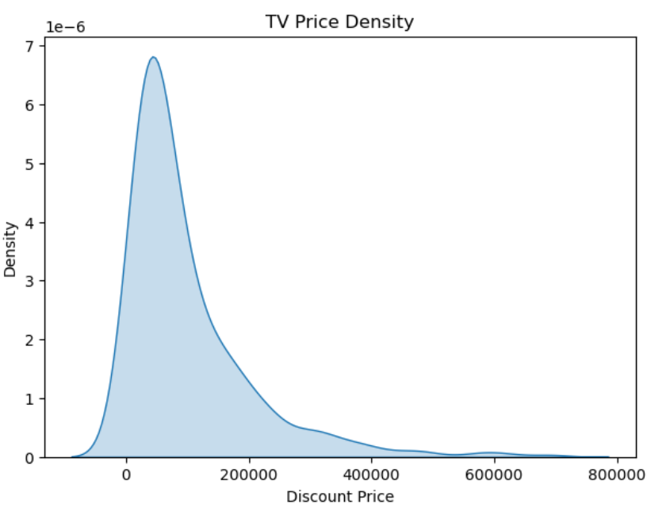
5. Price Density
This chart shows how television prices are distributed across different price ranges.
Insight: The highest peak represents the price range where TV listings are most concentrated.

Slide 16
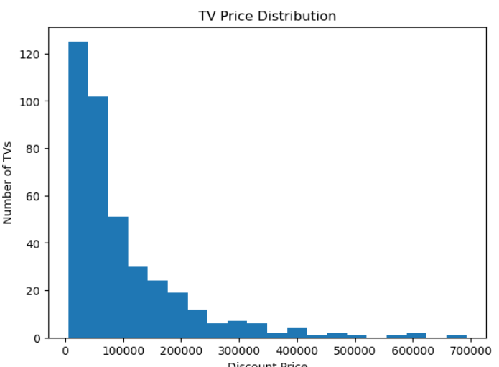
6.Price Distribution
This chart shows the overall distribution of television prices.
Insight:Most TVs are concentrated in certain price ranges, while relatively fewer TVs are found at very high prices.

Slide 17
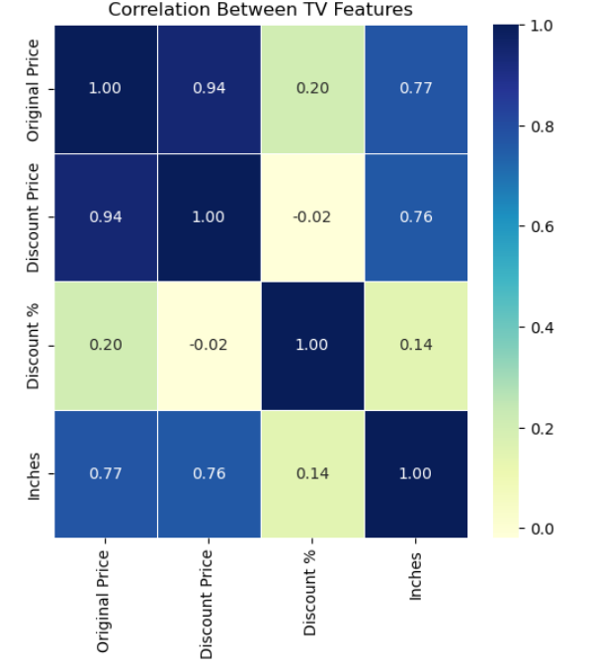
7.Correlation Analysis
This chart shows the correlation between numerical variables in the dataset.
Insight:Values closer to +1 indicate a strong positive relationship, values closer to -1 indicate a negative relationship, and values near 0 indicate a weak relationship.

Slide 18

Hypothesis Testing:
T-test:
To determine whether the average discounted price of Samsung TVs differs significantly from ₹10,000 ?
H₀ (Null Hypothesis): The average discount price of Samsung TVs is equal to ₹10,000.
H₁ (Alternative Hypothesis): The average discount price of Samsung TVs is different from ₹10,000.
Since the absolute T-statistic (10.4253) is greater than the T-critical value (1.9798), the null hypothesis is rejected. This indicates that the average discounted price of Samsung TVs is significantly different from ₹10,000 at the 5% significance level.

Slide 19
Future Scope:
Power BI Dashboard: Create interactive dashboards to analyze TV brands, prices, discounts, and screen sizes.
Automated Price Tracking: Use Python and Selenium to track TV prices and monitor changes over time.
SQL Database Integration: Store scraped TV data in MySQL to analyze pricing trends and compare brands.
Machine Learning Price Prediction: Explore price prediction models to estimate TV prices based on brand, screen size, and other available features.
Interactive Web Application: Use Streamlit to build an application for filtering TVs by brand, price, and screen size.

Slide 20
Conclusion :
This project shows how TV product details from a website can be collected and organized into a structured dataset. Using Python, the data was cleaned, analyzed, and presented through charts to understand TV brands, prices, screen sizes, and discounts.Overall, the project makes TV product information easier to analyze and compare, helping users understand pricing patterns and make better purchasing decisions.

Slide 21


Slide 22

THANK YOU

